Slide 1
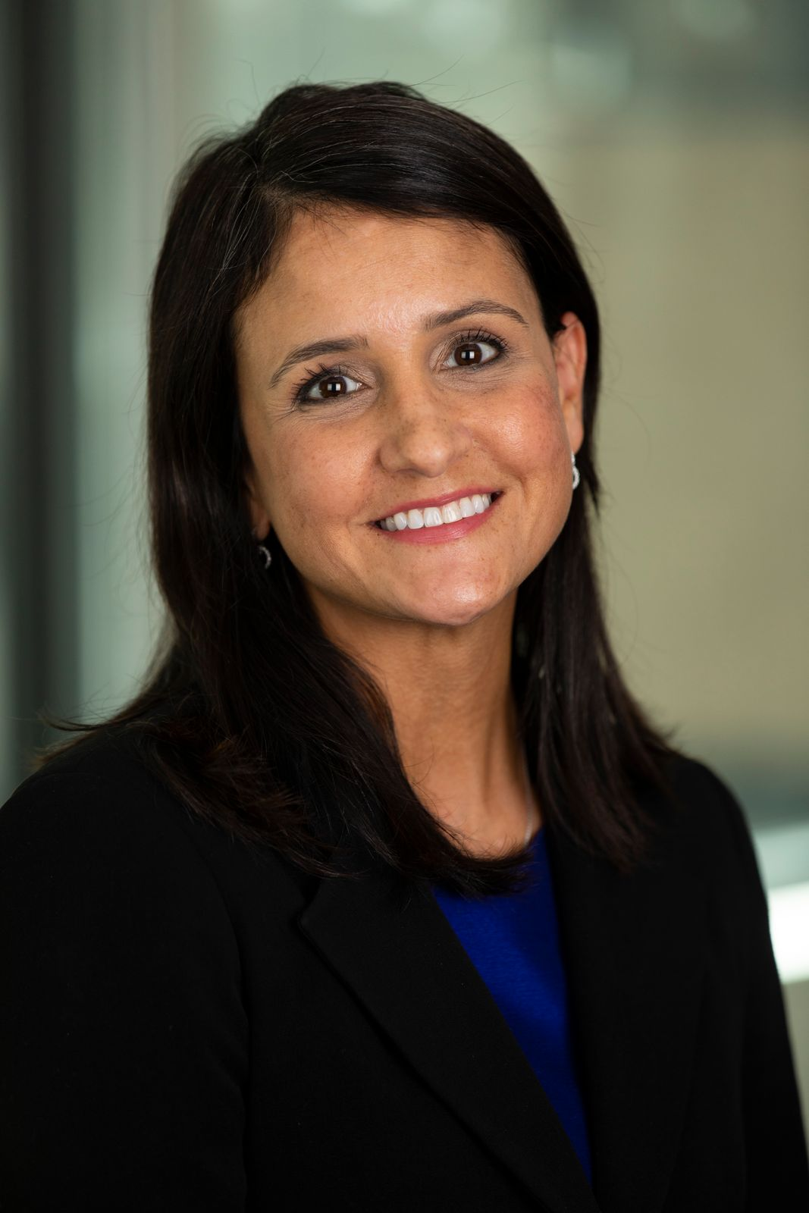
Peter Thomas Director of Quality Assurance NAATP
Covid-19 Impact on Addiction Treatment:
Survey Findings & Implications
Mark Dunn Director of Public Policy NAATP
Reyna Taylor VP of Public Policy and Advocacy NCBH

Slide 2
Overview of CDC McKinsey Data

Slide 3
Substance Use Increasing During Covid
A McKinsey consumer survey from March 2020 found:
1 in 4 respondents reported binge drinking at least once in the past week
1 in 5 reported taking prescription drugs for nonmedical reasons
1 in 7 reported using illicit drugs
According to a June 2020 survey conducted by the CDC, in the prior 30 days:
40% of US adults reported struggling with mental health or substance use
13% of adults started or increased substance use to cope with stress or emotions related to Covid, including
25% of 18-24 year-olds
22% of Hispanic respondents and 18% of Black respondents
25% of essential workers
33% of unpaid adult caregivers
44% of people receiving treatment for previously diagnosed PTSD, 27% for anxiety, 25% for depression
www.mckinsey.com/industries/healthcare-systems-and-services/our-insights/returning-to-resilience-the-impact-of-covid-19-on-behavioral-health
www.cdc.gov/mmwr/volumes/69/wr/mm6932a1.htm?s_cid=mm6932a1_x#T1_down

Slide 4
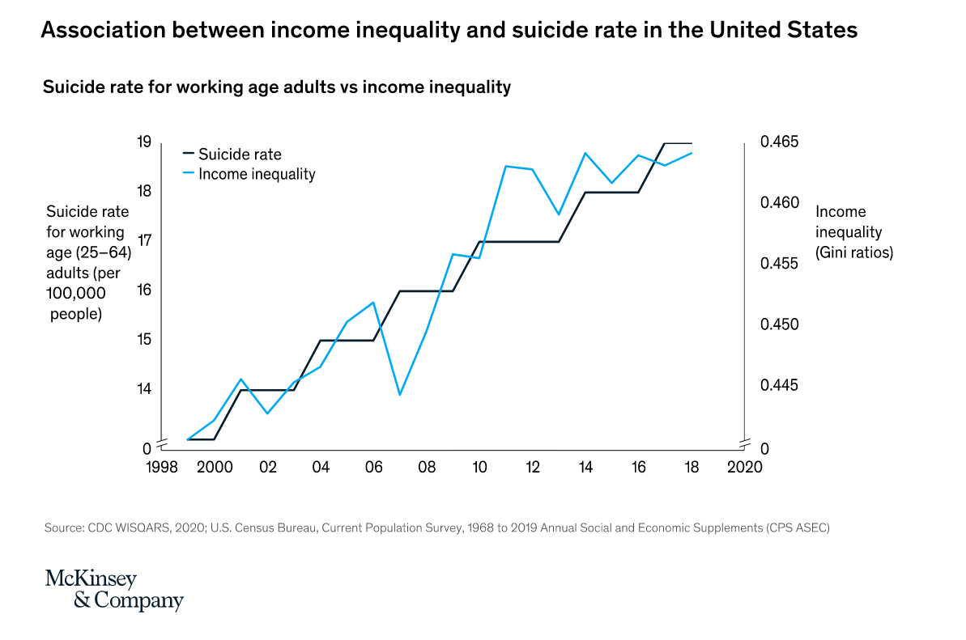
Suicide Ideation Increasing During Covid
June 2020 CDC survey also found, in the prior 30 days:
Nearly 11% of all respondents and 25% of young people ages 18-24 seriously considered suicide = 82.5 million young men and women
Suicide rates have been increasing with income inequalities
www.cdc.gov/mmwr/volumes/69/wr/mm6932a1.htm?s_cid=mm6932a1_x#T1_down
www.mckinsey.com/industries/healthcare-systems-and-services/our-insights/returning-to-resilience-the-impact-of-covid-19-on-behavioral-health

Slide 5
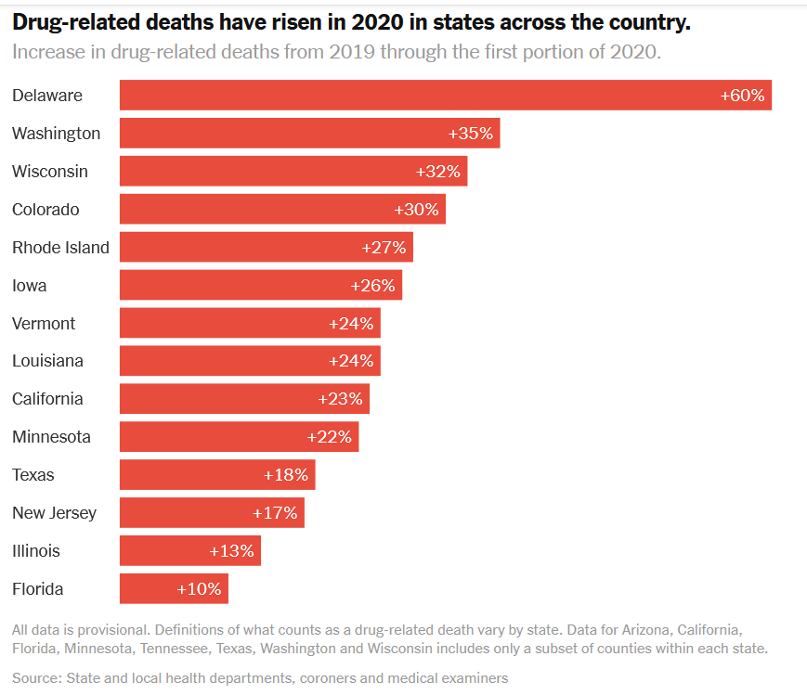
Drug Overdose Deaths Increasing During Covid
Nearly 72,000 Americans died from a drug overdose in 2019 - a new record
Preliminary 2020 data show 13% increase over same time last year
https://www.nytimes.com/interactive/2020/07/15/upshot/drug-overdose-deaths.html

Slide 6
Key Survey Data: NAATP and NCBH

Slide 7
NAATP and NCBH Data Overview
Landscape Incongruity
Not All Bleak
Demand is up
Capacity is down
Increased expenses
Decreased revenue
Reduced staffing
Increased staff burnout
Adapting to a virtual environment
80% offering virtual services
64% to continue these services
Providers showing agility
Opening new programs
Creating systems to serve more patients now and in the future
Resilience

Slide 8
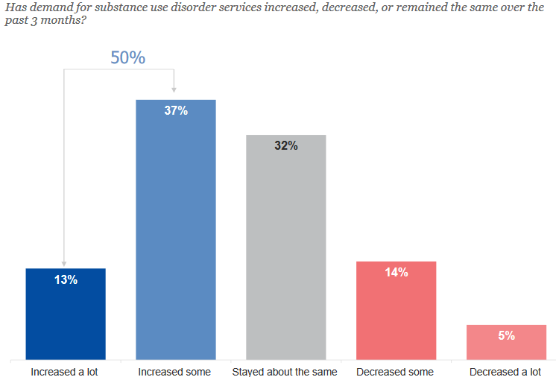
NAATP and NCBH Surveys Show Increased Demand for SUD Services
50% of NCBH members offering SUD services have seen an increase in demand
www.thenationalcouncil.org/wp-content/uploads/2020/09/NCBH_Member_Survey_Sept_2020_CTD2.pdf?daf=375ateTbd56

Slide 9
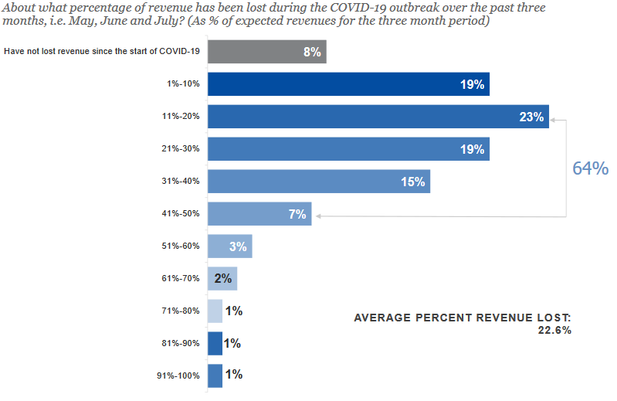
Revenue Losses
On average, NCBH members have lost more than 20% of their revenue; federal stimulus funding has only replaced 2%
www.thenationalcouncil.org/wp-content/uploads/2020/09/NCBH_Member_Survey_Sept_2020_CTD2.pdf?daf=375ateTbd56

Slide 10
Organization Capacity
43% report reduced capacity
Of those 35% cut by more than ¼
60% report reduced admissions
Half have closed programming
65% have canceled, rescheduled or turned away patients
This slide contains a combination of NAATP and NCBH Data

Slide 11
Staffing Capacity
Notes:
Number have varied slightly. 22-24% furloughed, 17-26% laid off

Slide 12
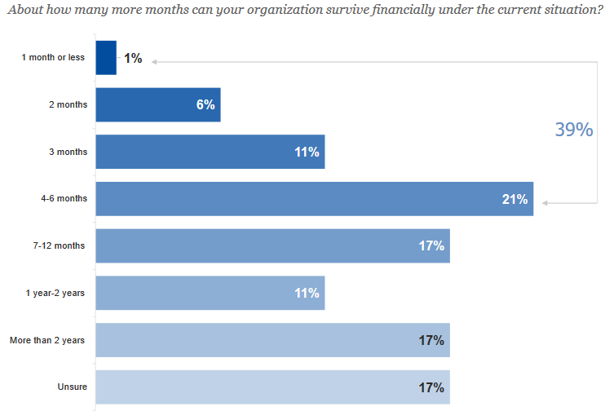
Forecast for the Future
Need for additional funding is significant; 39% of NCBH members believe they can only survive up to 6 months
www.thenationalcouncil.org/wp-content/uploads/2020/09/NCBH_Member_Survey_Sept_2020_CTD2.pdf?daf=375ateTbd56

Slide 13
Federal Response to Date

Slide 14
Overlapping National Health Emergencies
COVID-19 National Health Emergency Declared March 13, 2020
SUD National Health Emergency Declared October 26, 2017

Slide 15
Federal Response
To date, 4 COVID relief bills passed by Congress and signed.
In total they provide:
Testing $26 Billion
State and Local Government $217 Billion
Big Corporations $ 532 Billion
Small Business $810 Billion
Individuals $748 Billion
Public Health $312 Billion

Slide 16
Emergency Relief Disparity
Airline Industry: Given $58 billion
Mental Health and Substance Use Disorder Request: $38.5 Billion

Slide 17
Coalition Pushing on Stalled Response Efforts
Congress/Administration struggling to agree on 5th legislative relief bill.
NAATP and Coalition take a two-pronged approach:
Money dedicated to SUD treatment provider relief
Use of existing appropriations directed at SUD treatment provider relief
HHS Declares additional $20 Billion available for healthcare providers, specifically mentioning SUD treatment.

Slide 18
Public Health and Social Services Emergency Relief Fund – New Phase 3 Portal
Apply by Friday, November 6, 2020
All eligible providers, including certain behavioral health providers and Medicaid, Medicaid Managed Care, CHIP, or Medicare billing providers, may now make an application to the Phase 3 General Distribution portal. You need to reapply to the portal to receive funds. See FAQ for additional information.
To help you navigate the portal process, NCBH has updated their step-by-step “Rules of the Road” guide to include processes for all eligible providers. In addition, HHS has shared a step-by-step resource to help with this process – see here

Slide 19
Advocacy is Crucial: Here’s what you can do

Slide 20
Stakeholder Engagement and Advocacy
Your voice matters and You CAN make a difference.
Federal and State Policymakers listen to constituents.
When’s the last time you connected with your legislators? Three ways you can participate:
Schedule a virtual meeting with legislators or staff
Host a virtual site visit with your legislator
Attend a tele-town hall meeting hosted by your legislator
Want to do more? Write your legislators today
https://www.thenationalcouncil.org/policy-action/write-your-legislators/#/

Slide 21
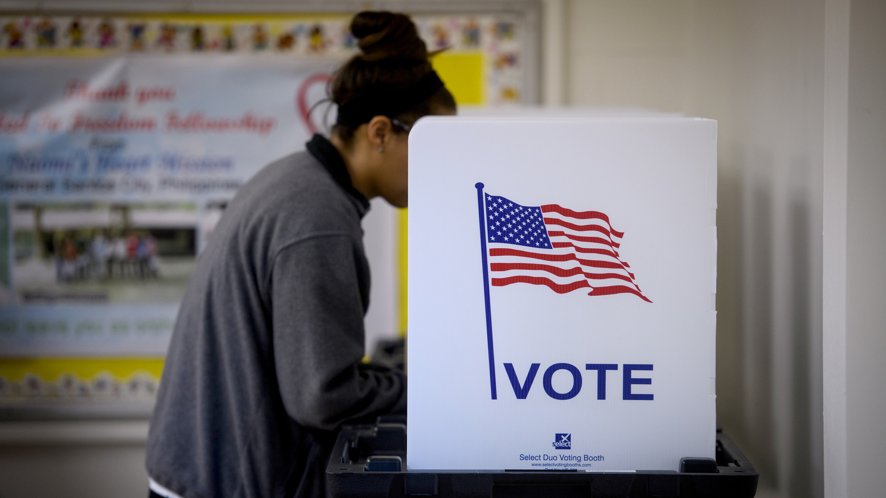
For Health’s Sake, VOTE!

Slide 22
Stakeholder Engagement and Advocacy
https://www.naatp.org/programs/advocacy

Slide 23
Resources
https://www.thenationalcouncil.org/covid19/
https://www.naatp.org/covid-resources

Slide 24
Thank you!

